Slide 1
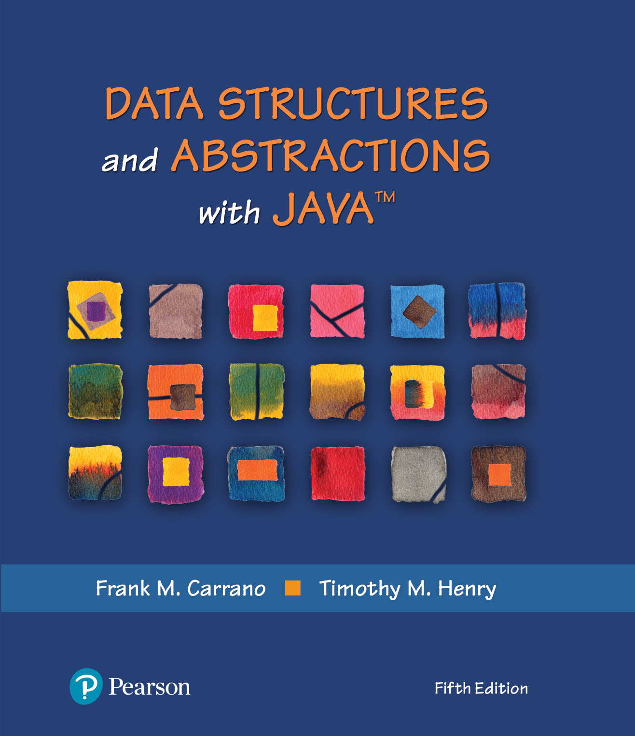
Data Structures and Abstractions with Java™
5th Edition
Module 7 - Stacks
Using:
Chapter 5 – Stacks
Chapter 6 – Stack Implementation

Slide 2
Overview Of Restricted Structures
All restricted structures severely restrict the basic operations and access modes
The two most commonly used restricted structures are Stack and Queue
Both can be implemented as array-based or linked structures
Their restrictions are consistent with some applications, and the performance of Stack and Queue is excellent
A priority queue is a restricted structure used in scheduling applications
Java’s API Stack class is a generic stack structure
2

Slide 3
Restrictions on Restricted Structures
Operation restrictions
Update is not supported
Insert is supported (but restricted)
Fetch and Delete are combined into one operation
Access mode restrictions
Key field mode is not supported
Node number mode is severely restricted
Still, they are ideally suited for some applications
3

Slide 4
Restrictions on Node Number Access Mode
Can’t say “Fetch-and-Delete the 3rd node”
Can only say “Fetch-and-Delete”
For a Queue: the node returned and deleted is the node in the structure the longest time
For a Stack: the node returned and deleted is the node in the structure the shortest time

Slide 5
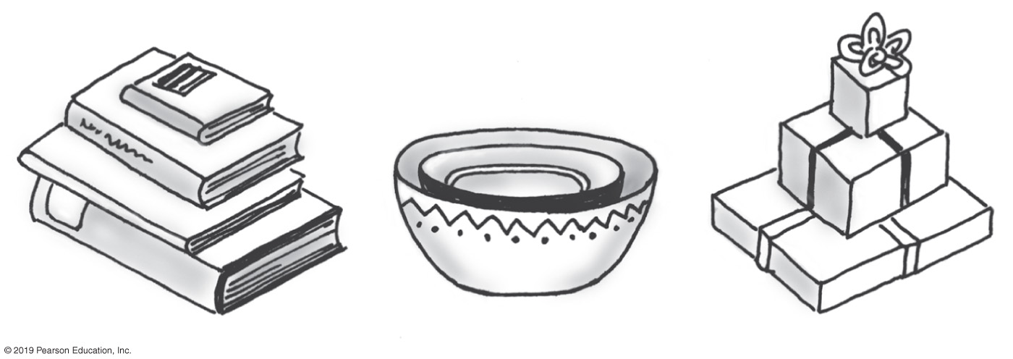
Stacks
Add item on top of stack
Remove item that is topmost
Last In, First Out … LIFO
FIGURE 5-1 Some familiar stacks

Slide 6
Stack
Stack has its own terminology
When based on an array, its operation algorithms are simple and fast
It is implemented as a separate class to promote software reusability and generic conversion
Used in many applications
Its two operations are sometime expanded and it can be made dynamic
6

Slide 7
Specifications of the ADT Stack
Data
A collection of objects in reverse chronological order and having the same data type
Pseudocode | UML | Description
push(newEntry) | +push(newEntry: T): void | Task: Adds a new entry to the top of the stack. Input: newEntry is the new entry. Output: None.
pop() | +pop(): T | Task: Removes and returns the stack’s top entry. Input: None. Output: Returns the stack’s top entry. Throws an exception if the stack is empty before the operation.
peek() | +peek(): T | Task: Retrieves the stack’s top entry without changing the stack in any way. Input: None. Output: Returns the stack’s top entry. Throws an exception if the stack is empty.
isEmpty() | +isEmpty(): boolean | Task: Detects whether the stack is empty. Input: None. Output: Returns true if the stack is empty.
clear() | +clear(): void | Task: Removes all entries from the stack. Input: None. Output: None.

Slide 8
Design Decision
When stack is empty
What to do with pop and peek?
Possible actions
Assume that the ADT is not empty;
Return null.
Throw an exception (which type?).

Slide 9
Interface for the ADT Stack
/** An interface for the ADT stack. */
public interface StackInterface<T>
{
/** Adds a new entry to the top of this stack.
@param newEntry An object to be added to the stack. */
public void push(T newEntry);
/** Removes and returns this stack's top entry.
@return The object at the top of the stack.
@throws EmptyStackException if the stack is empty before the operation. */
public T pop();
/** Retrieves this stack's top entry.
@return The object at the top of the stack.
@throws EmptyStackException if the stack is empty. */
public T peek();
/** Detects whether this stack is empty.
@return True if the stack is empty. */
public boolean isEmpty();
/** Removes all entries from this stack. */
public void clear();
} // end StackInterface
LISTING 5-1 An interface for the ADT stack

Slide 10
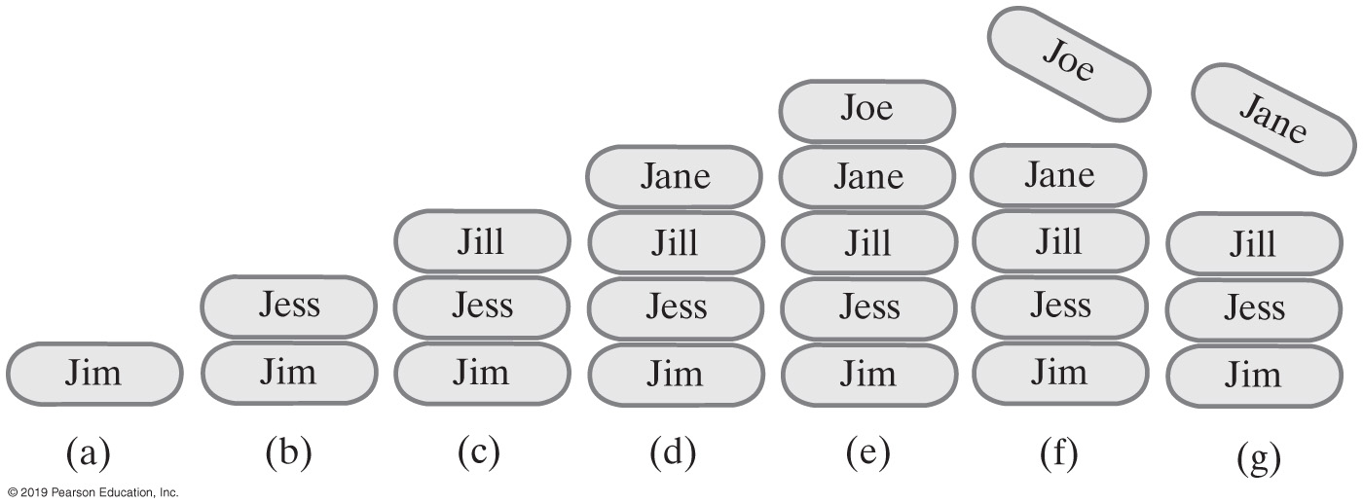
Example of a Stack
StackInterface<String> stringStack = new OurStack<>();
(a) stringStack.push(“Jim”);
(b) stringStack.push("Jess");
(c) stringStack.push("Jill");
(d) stringStack.push("Jane");
(e) stringStack.push("Joe");
(f) stringStack.pop();
(g) stringStack.pop();
FIGURE 5-2 A stack of strings
Notes:
FIGURE 5-2
A stack of strings after (a) push adds Jim; (b) push adds Jess; (c) push adds Jill; (d) push adds Jane; (e) push adds Joe; (f ) pop retrieves and removes Joe; (g) pop retrieves and removes Jane

Slide 11
Security Note
Design guidelines
Use preconditions and postconditions to document assumptions.
Do not trust client to use public methods correctly.
Avoid ambiguous return values.
Prefer throwing exceptions instead of returning values to signal problem.

Slide 12
Processing Algebraic Expressions
Infix:
each binary operator appears between its operands a + b
Prefix:
each binary operator appears before its operands + a b
Postfix:
each binary operator appears after its operands a b +
Balanced expressions: delimiters paired correctly

Slide 13
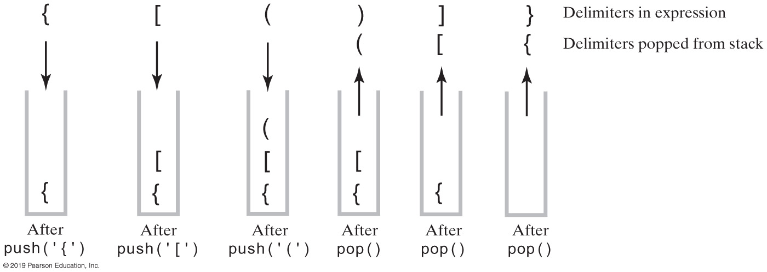
Processing Algebraic Expressions
FIGURE 5-3 The contents of a stack during the scan of an expression that contains the balanced delimiters{ [ ( ) ] }

Slide 14
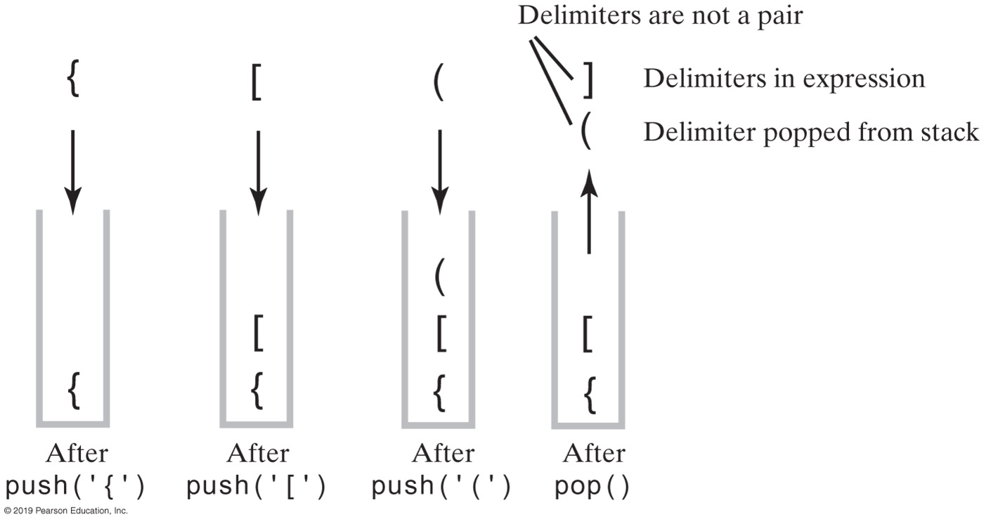
Processing Algebraic Expressions
FIGURE 5-4 The contents of a stack during the scan of an expression that contains the unbalanced delimiters { [ ( ] ) }

Slide 15
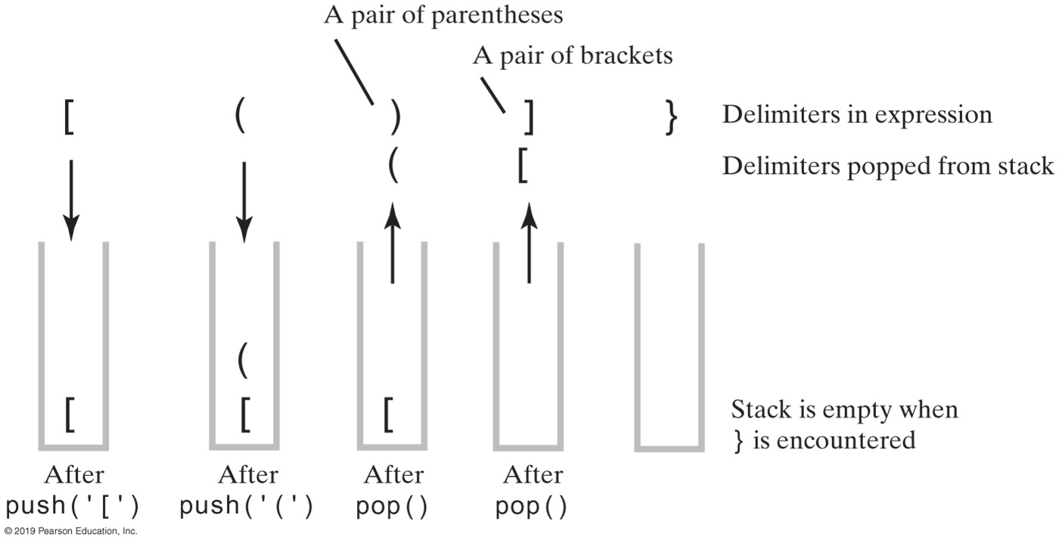
Processing Algebraic Expressions
FIGURE 5-5 The contents of a stack during the scan of an expression that contains the unbalanced delimiters [ ( ) ] }

Slide 16
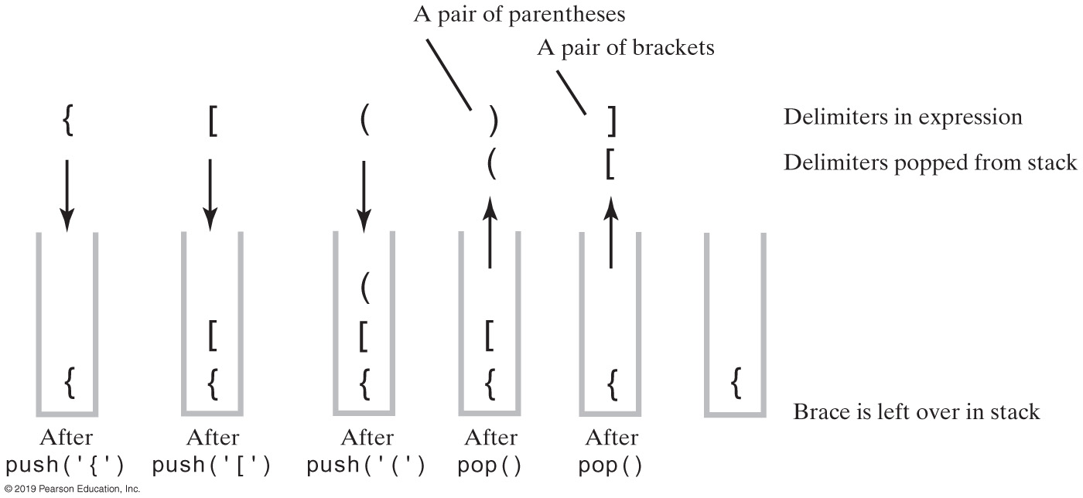
Processing Algebraic Expressions
FIGURE 5-6 The contents of a stack during the scan of an expression that contains the unbalanced delimiters { [ ( ) ]

Slide 17
Processing Algebraic Expressions
Algorithm checkBalance(expression)
// Returns true if the parentheses, brackets, and braces in an expression are paired correctly.
isBalanced = true // The absence of delimiters is balanced
while ((isBalanced == true) and not at end of expression)
{
nextCharacter = next character in expression
switch (nextCharacter)
{
case '(': case '[': case '{':
Push nextCharacter onto stack
break
case ')': case ']': case '}':
if (stack is empty)
isBalanced = false
else
{
openDelimiter = top entry of stack
Pop stack
isBalanced = true or false according to whether openDelimiter and
nextCharacter are a pair of delimiters
}
break
}
}
if (stack is not empty)
isBalanced = false
return isBalanced
Algorithm to process for balanced expression.

Slide 18
Implementation of Algorithm (Part 1)
/** A class that checks whether the parentheses, brackets, and braces
in a string occur in left/right pairs. */
public class BalanceChecker
{
// Returns true if the given characters, open and close, form a pair
// of parentheses, brackets, or braces.
private static boolean isPaired(char open, char close)
{
return (open == '(' && close == ')') ||
(open == '[' && close == ']') ||
(open == '{' && close == '}');
} // end isPaired
/** Decides whether the parentheses, brackets, and braces
in a string occur in left/right pairs.
@param expression A string to be checked.
@return True if the delimiters are paired correctly. */
public static boolean checkBalance(String expression)
{
[ SEE NEXT SLIDE FOR IMPLEMENTATION]
} // end checkBalance
} // end BalanceChecker
LISTING 5-2 The class BalanceChecker

Slide 19
Implementation of Algorithm (Part 2)
StackInterface<Character> openDelimiterStack = new LinkedStack<>();
int characterCount = expression.length();
boolean isBalanced = true;
int index = 0;
char nextCharacter = ' ';
while (isBalanced && (index < characterCount)) {
nextCharacter = expression.charAt(index);
switch (nextCharacter) {
case '(': case '[': case '{':
openDelimiterStack.push(nextCharacter);
break;
case ')': case ']': case '}':
if (openDelimiterStack.isEmpty())
isBalanced = false;
else {
char openDelimiter = openDelimiterStack.pop();
isBalanced = isPaired(openDelimiter, nextCharacter);
} // end if
break;
default: break; // Ignore unexpected characters
} // end switch
index++;
} // end while
if (!openDelimiterStack.isEmpty())
isBalanced = false;
return isBalanced;
} // end checkBalance

Slide 20
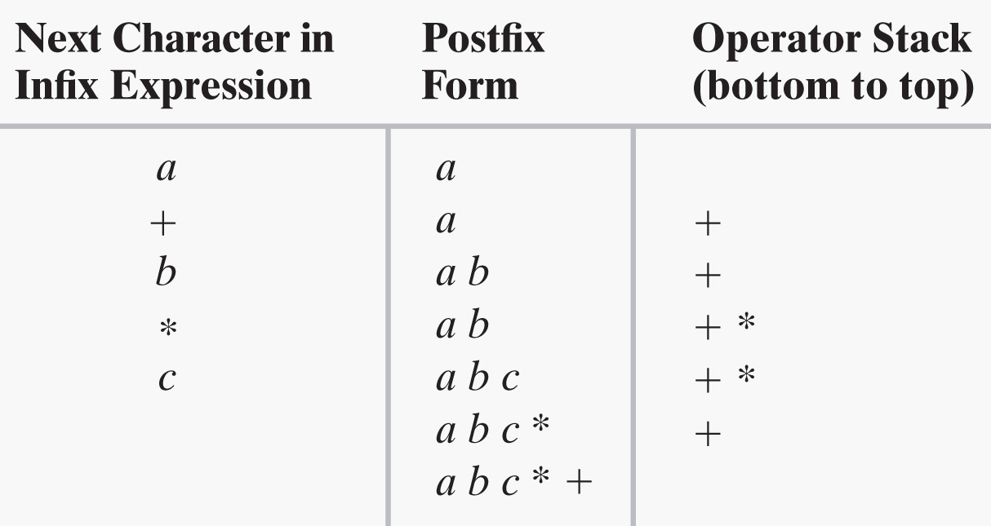
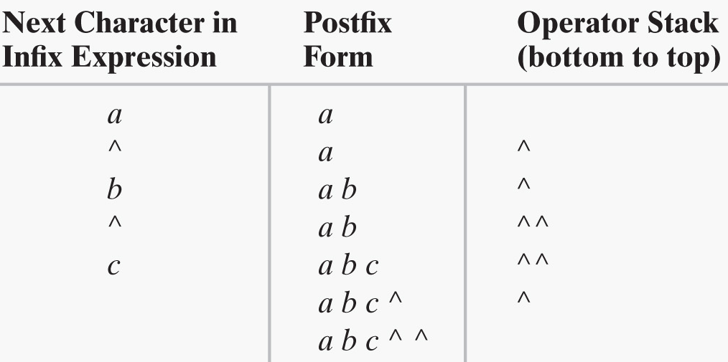

Converting Infix to Postfix
a + b * c
a ^ b ^ c
a - b + c
FIGURES 5-7 & 5-8 Converting the infix expressions to postfix form

Slide 21
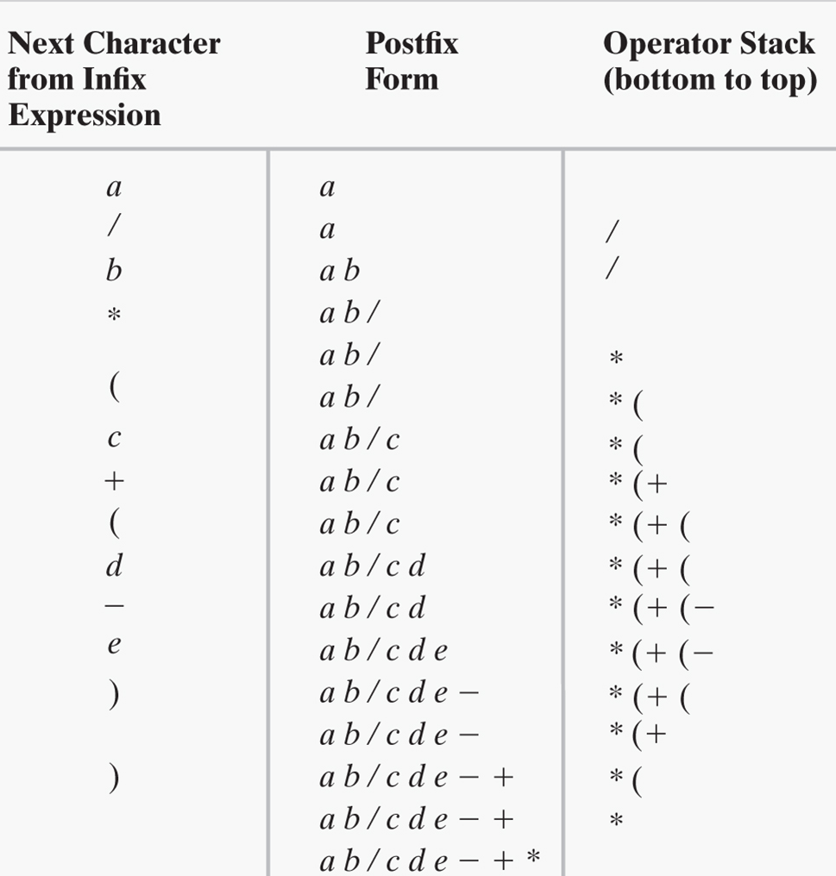
Converting Infix to Postfix
a / b * (c + (d - e))
FIGURE 5-9 Steps in converting an infix expression to postfix form

Slide 22
Infix-to-postfix Conversion
To convert an infix expression to postfix form, you take the following actions, according to the symbols you encounter, as you process the infix expression from left to right:
Operand | Append each operand to the end of the output expression.
Operator ^ | Push ^ onto the stack.
Operator +, -, *, or / | Pop operators from the stack, appending them to the output expression, until either the stack is empty or its top entry has a lower precedence than the newly encountered operator. Then push the new operator onto the stack.
Open parenthesis | Push ( onto the stack.
Close parenthesis | Pop operators from the stack and append them to the output expression until an open parenthesis is popped. Discard both parentheses.

Slide 23
Infix-to-postfix Algorithm (Part 1)
Algorithm convertToPostfix(infix)
// Converts an infix expression to an equivalent postfix expression.
operatorStack = a new empty stack
postfix = a new empty string
while (infix has characters left to parse)
{
nextCharacter = next nonblank character of infix
switch (nextCharacter)
{
case variable:
Append nextCharacter to postfix
break
case '^' :
operatorStack.push(nextCharacter)
break
case '+' : case '-' : case '*' : case '/' :
while (!operatorStack.isEmpty() and
precedence of nextCharacter <= precedence of operatorStack.peek())
{
Append operatorStack.peek() to postfix
operatorStack.pop()
}
operatorStack.push(nextCharacter)
break
Algorithm for converting infix to postfix expressions.

Slide 24
Infix-to-postfix Algorithm (Part 2)
case '( ' :
operatorStack.push(nextCharacter)
break
case ')' : // Stack is not empty if infix expression is valid
topOperator = operatorStack.pop()
while (topOperator != '(')
{
Append topOperator to postfix
topOperator = operatorStack.pop()
}
break
default:
break // Ignore unexpected characters
}
}
while (!operatorStack.isEmpty())
{
topOperator = operatorStack.pop()
Append topOperator to postfix
}
return postfix
Algorithm for converting infix to postfix expressions.

Slide 25
Evaluating Postfix Expressions
Algorithm evaluatePostfix(postfix)
// Evaluates a postfix expression.
valueStack = a new empty stack
while (postfix has characters left to parse)
{
nextCharacter = next nonblank character of postfix
switch (nextCharacter)
{
case variable:
valueStack.push(value of the variable nextCharacter)
break
case '+' : case '-' : case '*' : case '/' : case '^' :
operandTwo = valueStack.pop()
operandOne = valueStack.pop()
result = the result of the operation in nextCharacter and
its operands operandOne and operandTwo
valueStack.push(result)
break
default: break // Ignore unexpected characters
}
}
return valueStack.peek()
Algorithm for evaluating postfix expressions.

Slide 26
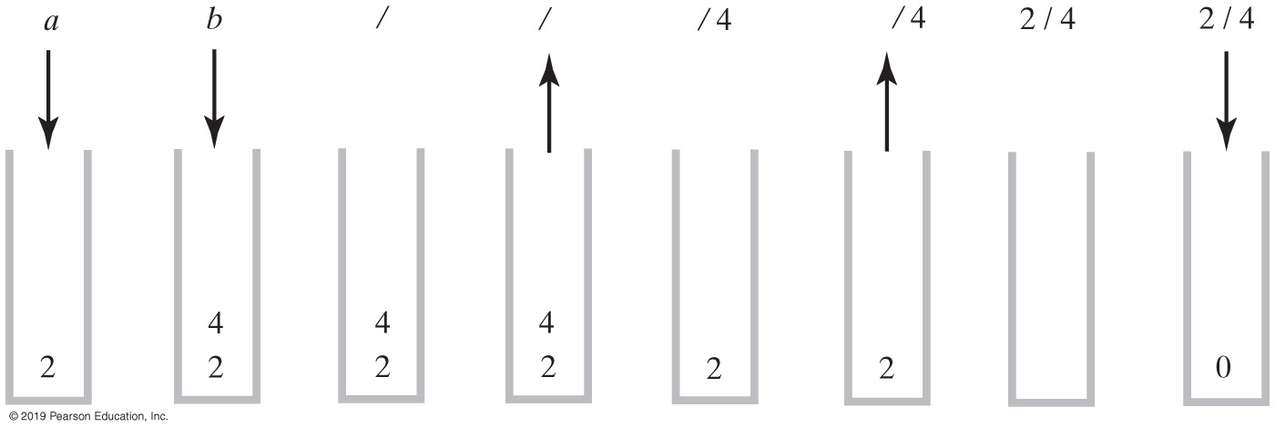
Evaluating Infix Expressions
FIGURE 5-10 The stack during the evaluation of the postfix expression a b / when a is 2 and b is 4

Slide 27
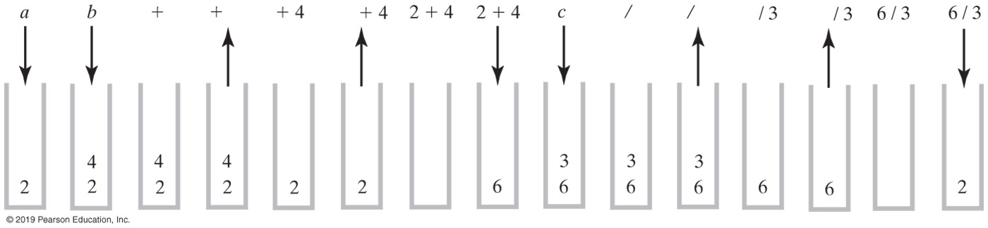
Evaluating Infix Expressions
FIGURE 5-11 The stack during the evaluation of the postfix expression a b + c / when a is 2, b is 4, and c is 3

Slide 28
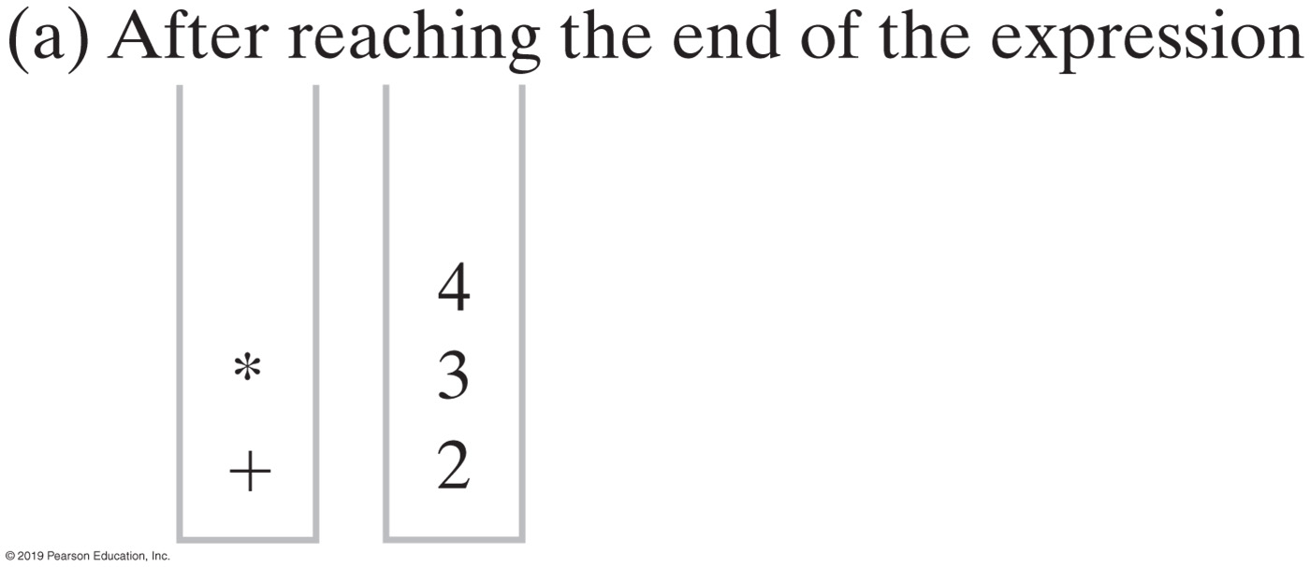
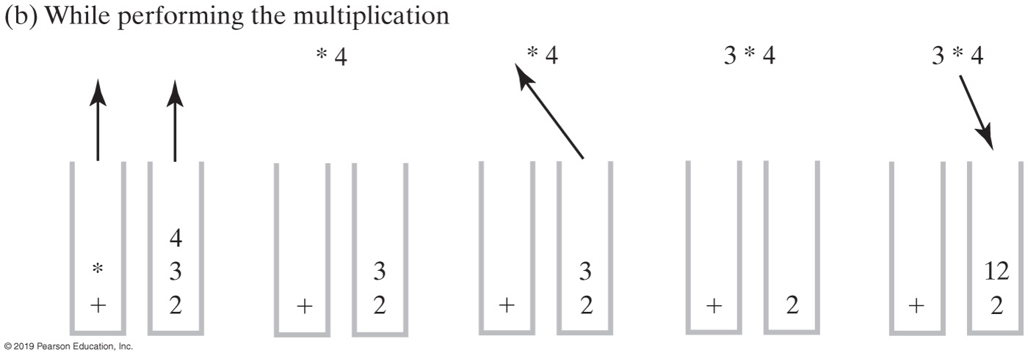
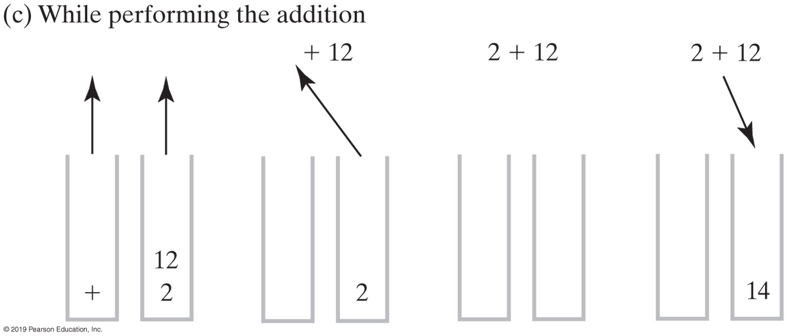
Evaluating Infix Expressions
FIGURE 5-12
Two stacks during the evaluation of
a + b * c when a is 2, b is 3, and c is 4

Slide 29
Evaluating Infix Expressions (Part 1)
Algorithm evaluateInfix(infix) // Evaluates an infix expression.
operatorStack = a new empty stack
valueStack = a new empty stack
while (infix has characters left to process)
{
nextCharacter = next nonblank character of infix
switch (nextCharacter)
{
case variable:
valueStack.push(value of the variable nextCharacter)
break
case '^' :
operatorStack.push(nextCharacter)
break
case '+' : case '-' : case '*' : case '/' :
while (!operatorStack.isEmpty() and
precedence of nextCharacter <= precedence of operatorStack.peek())
{
// Execute operator at top of operatorStack
topOperator = operatorStack.pop()
operandTwo = valueStack.pop()
operandOne = valueStack.pop()
result = the result of the operation in
topOperator and its operands operandOne and operandTwo
valueStack.push(result)
}
operatorStack.push(nextCharacter)
break

Slide 30
Evaluating Infix Expressions (Part 2)
case '(' :
operatorStack.push(nextCharacter)
break
case ')' : // Stack is not empty if infix expression is valid
topOperator = operatorStack.pop()
while (topOperator != ‘(')
{
operandTwo = valueStack.pop()
operandOne = valueStack.pop()
result = the result of the operation in topOperator and its operands operandOne and operandTwo
valueStack.push(result)
topOperator = operatorStack.pop()
}
break
default: break // Ignore unexpected characters
}
}
while (!operatorStack.isEmpty())
{
topOperator = operatorStack.pop()
operandTwo = valueStack.pop()
operandOne = valueStack.pop()
result = the result of the operation in topOperator and its operands operandOne and operandTwo
valueStack.push(result)
}
return valueStack.peek()

Slide 31
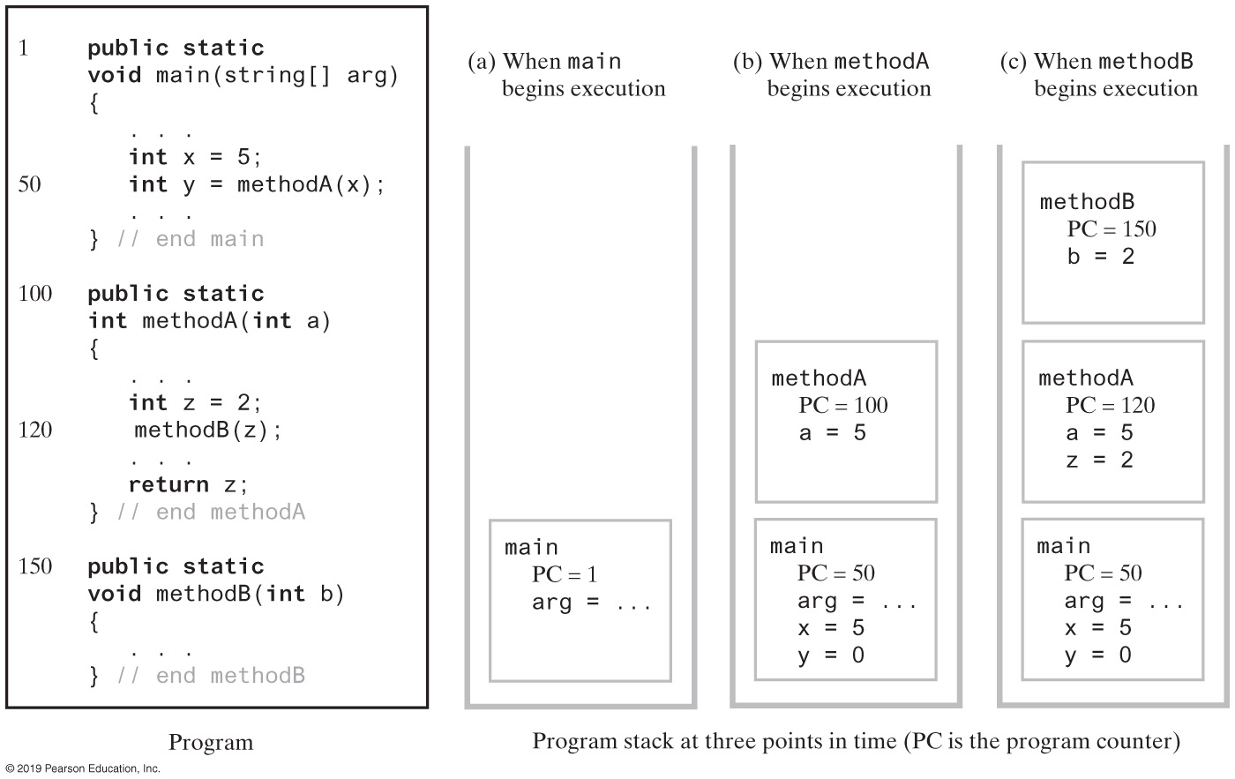
The Application Program Stack
FIGURE 5-13 The program stack as a program executes

Slide 32
Java Class Library: The Class Stack
Found in java.util
Methods
A constructor – creates an empty stack
public T push(T item);
public T pop();
public T peek();
public boolean empty();

Slide 33
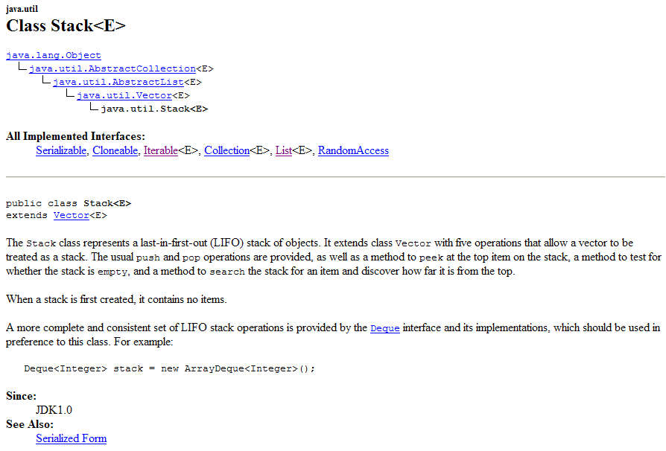
Java class Stack

Slide 34
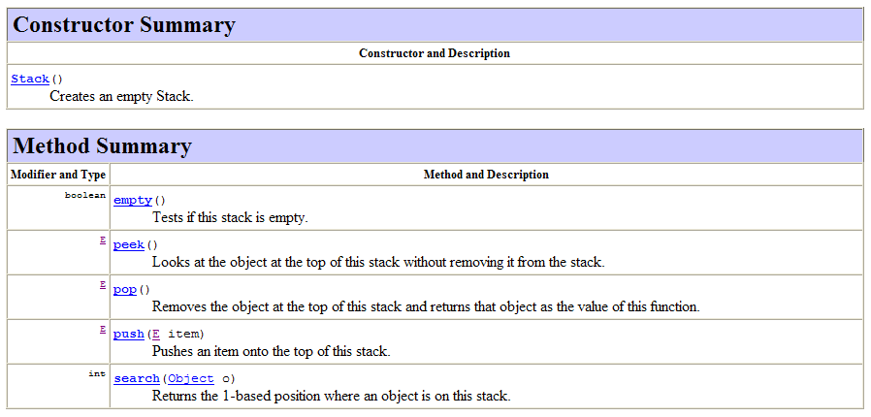
Java class Stack

Slide 35
Linked Implementation
Each operation involves top of stack
push
pop
peek
Head of linked list easiest, fastest to access
Let this be the top of the stack

Slide 36
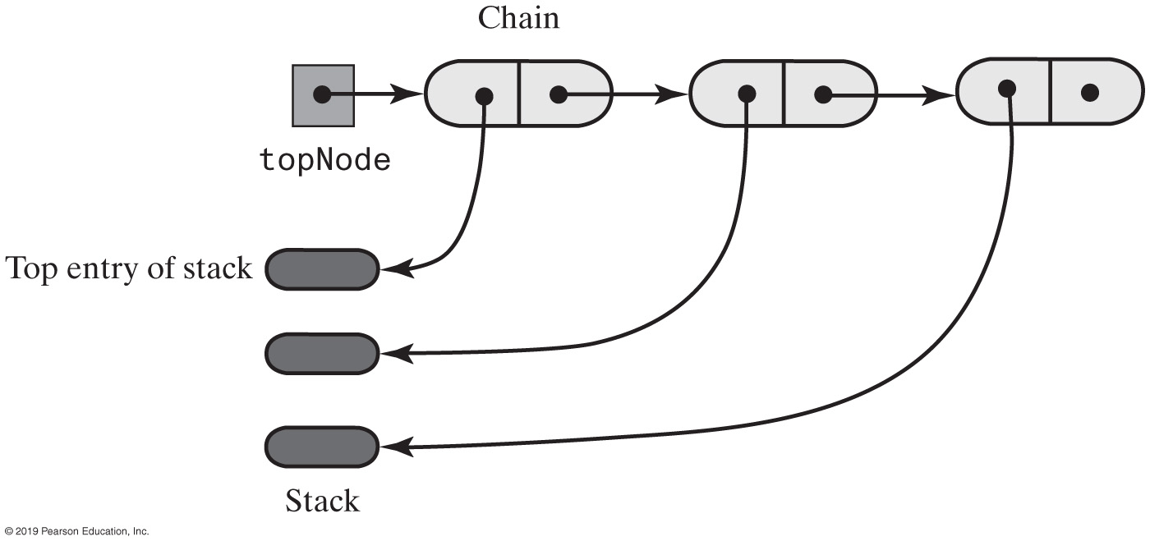
Linked Implementation
FIGURE 6-1 A chain of linked nodes that implements a stack

Slide 37
Linked Implementation of a Stack
/** A class of stacks whose entries are stored in a chain of nodes. */
public final class LinkedStack<T> implements StackInterface<T>
{
private Node topNode; // References the first node in the chain
public LinkedStack()
{
topNode = null;
} // end default constructor
// < Implementations of the stack operations go here. >
// . . .
private class Node
{
private T data; // Entry in stack
private Node next; // Link to next node
// < Implementations of the node operations go here. >
} // end Node
} // end LinkedStack
LISTING 6-1 An outline of a linked implementation of the ADT stack

Slide 38
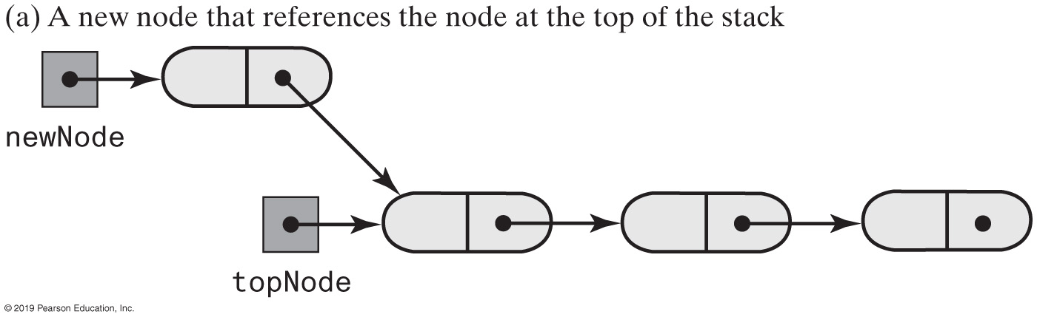
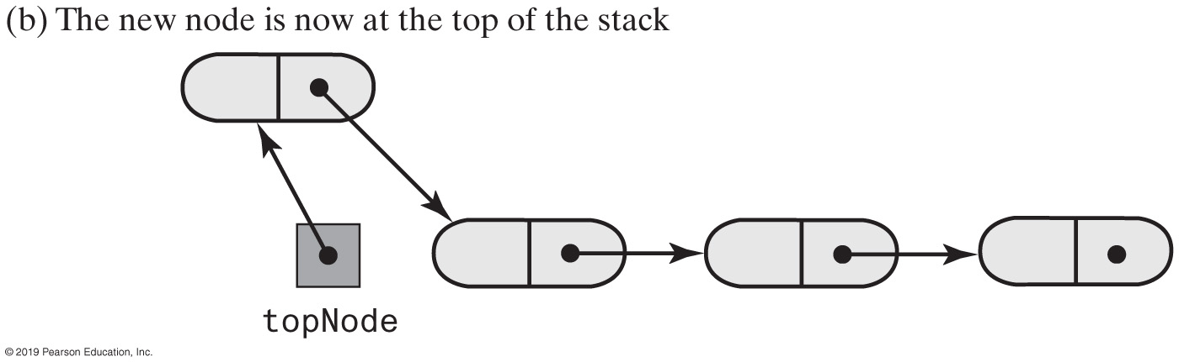
Linked Implementation of a Stack
FIGURE 6-2 Adding a new node to the top of a linked stack

Slide 39
Linked Implementation of a Stack
public void push(T newEntry)
{
Node newNode = new Node(newEntry, topNode);
topNode = newNode;
} // end push
Definition of push

Slide 40
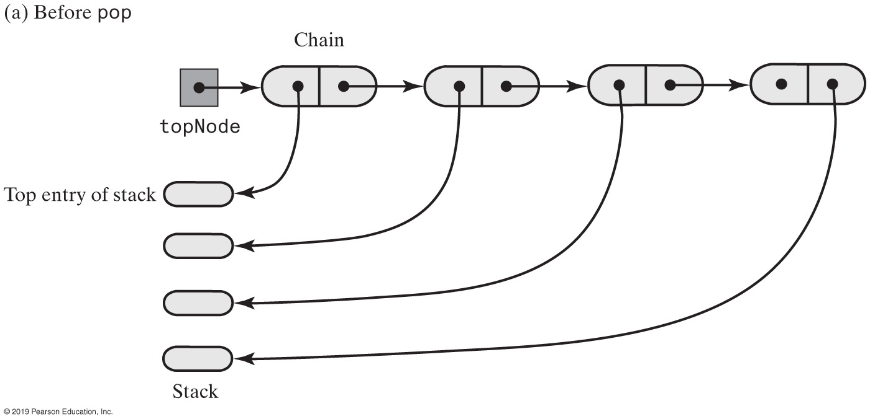
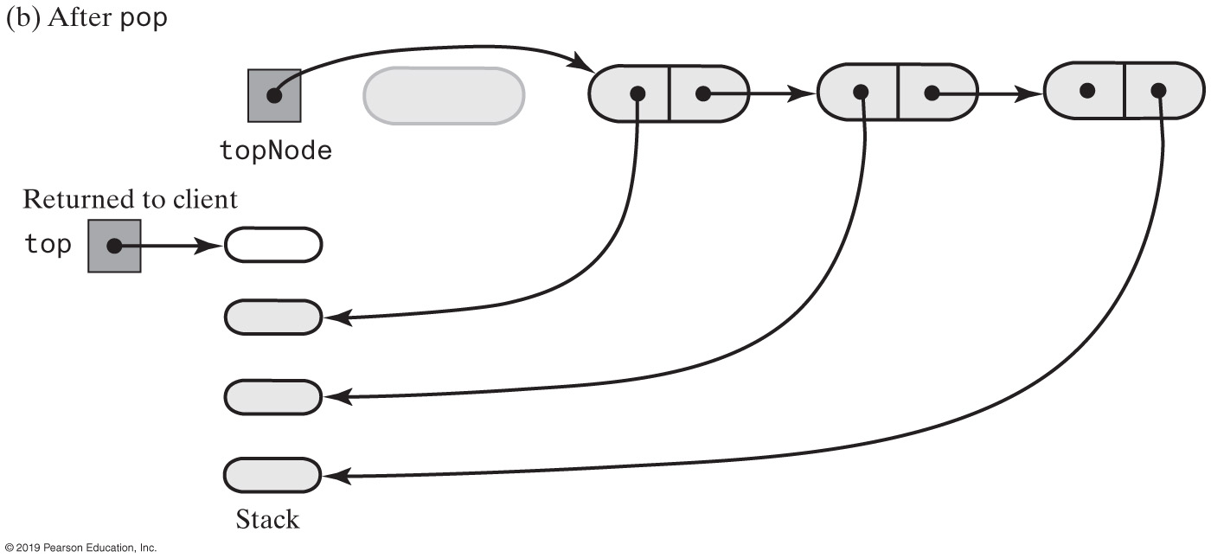
Linked Implementation of a Stack
FIGURE 6-3 The stack before and after pop deletes the first node in the chain

Slide 41
Linked Implementation
public T peek()
{
if (isEmpty())
throw new EmptyStackException();
else
return topNode.getData();
} // end peek
public T pop()
{
T top = peek(); // Might throw EmptyStackException
// Assertion: topNode != null
topNode = topNode.getNextNode();
return top;
} // end pop
Definition of peek and pop

Slide 42
Linked Implementation
public boolean isEmpty()
{
return topNode == null;
} // end isEmpty
public void clear()
{
topNode = null;
} // end clear
Definition of isEmpty and clear.

Slide 43
Array-Based Stack Implementation
Each operation involves top of stack
push
pop
peek
End of the array easiest to access
Let this be top of stack
Let first entry be bottom of stack

Slide 44
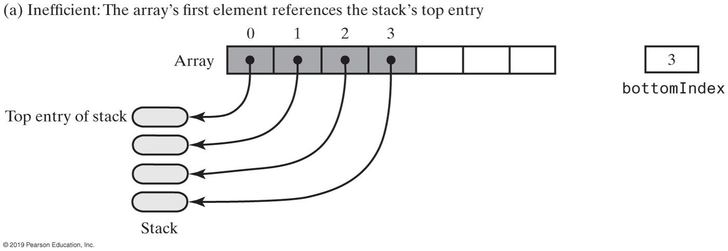
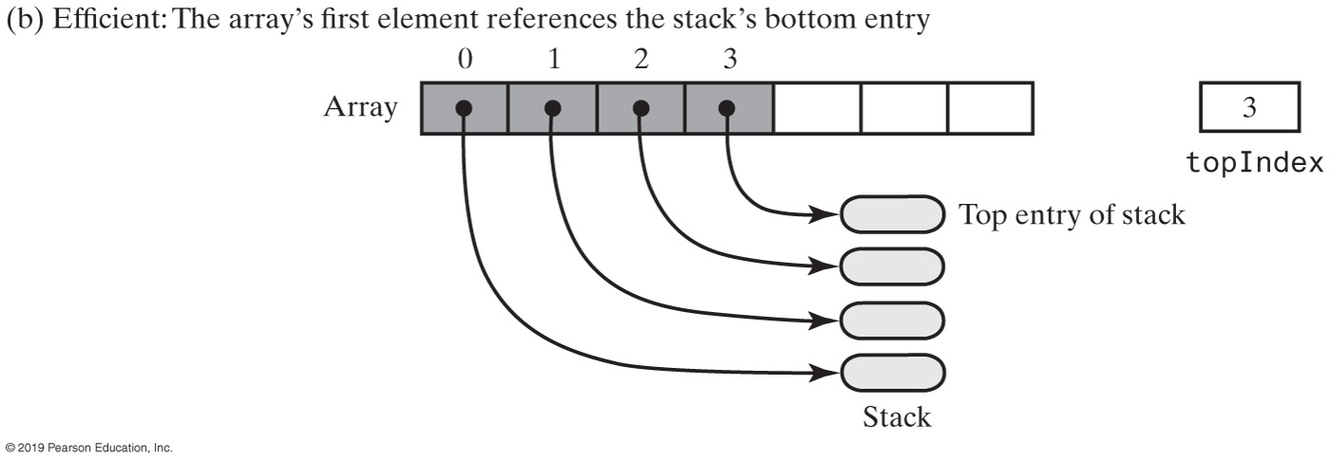
Array-Based Stack Implementation
FIGURE 6-4 Two array representations of a stack

Slide 45
Array-Based Stack Implementation
/** A class of stacks whose entries are stored in an array. */
public final class ArrayStack<T> implements StackInterface<T>
{
private T[] stack; // Array of stack entries
private int topIndex; // Index of top entry
private boolean integrityOK = false;
private static final int DEFAULT_CAPACITY = 50;
private static final int MAX_CAPACITY = 10000;
public ArrayStack()
{
this(DEFAULT_CAPACITY);
} // end default constructor
public ArrayStack(int initialCapacity)
{
integrityOK = false;
checkCapacity(initialCapacity);
// The cast is safe because the new array contains null entries
@SuppressWarnings("unchecked")
T[] tempStack = (T[])new Object[initialCapacity];
stack = tempStack;
topIndex = -1;
integrityOK = true;
} // end constructor
// < Implementations of the stack operations go here. >
// . . .
} // end ArrayStack
LISTING 6-2 An outline of an array-based implementation of the ADT stack

Slide 46
Array-Based Stack Implementation
public void push(T newEntry)
{
checkInyegrity();
ensureCapacity();
stack[topIndex + 1] = newEntry;
topIndex++;
} // end push
private void ensureCapacity()
{
if (topIndex >= stack.length - 1) // If array is full, double its size
{
int newLength = 2 * stack.length;
checkCapacity(newLength);
stack = Arrays.copyOf(stack, newLength);
} // end if
} // end ensureCapacity
Adding to the top.

Slide 47
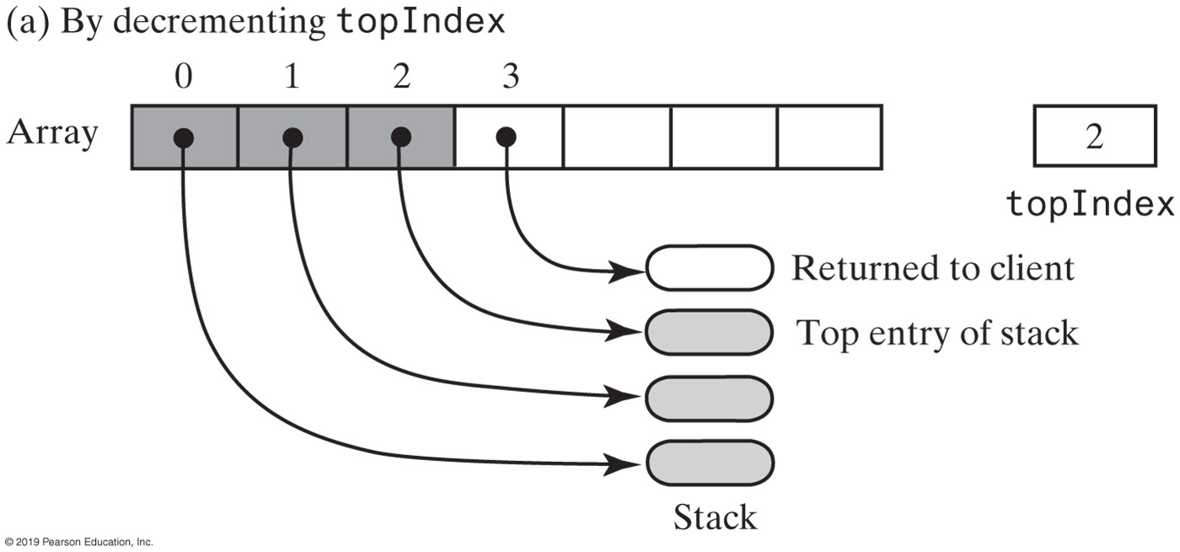
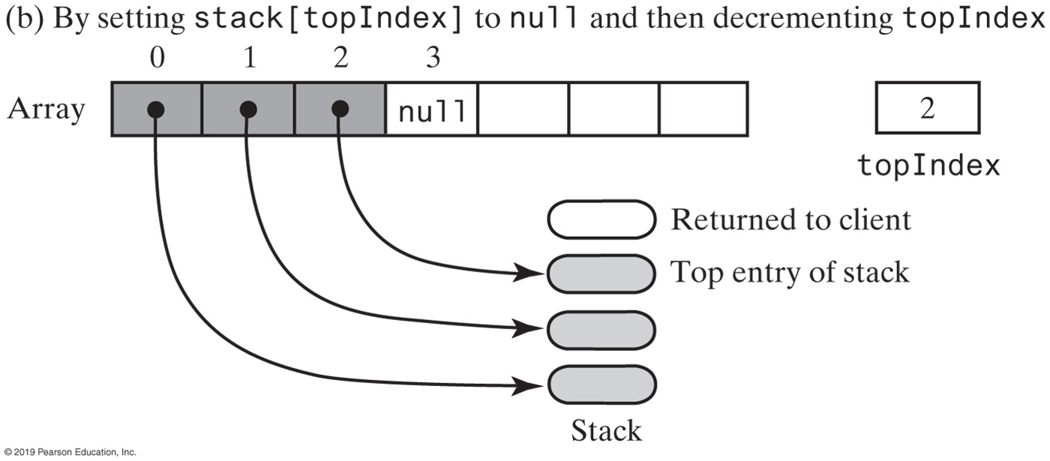
Array-Based Stack Implementation
FIGURE 6-5 An array-based stack after its top entry is removed in two different ways

Slide 48
Array-Based Stack Implementation
public T peek()
{
checkIntegrity();
if (isEmpty())
throw new EmptyStackException();
else
return stack[topIndex];
} // end peek
public T pop()
{
checkIntegrity();
if (isEmpty())
throw new EmptyStackException();
else
{
T top = stack[topIndex];
stack[topIndex] = null;
topIndex--;
return top;
} // end if
} // end pop
Retrieving the top, operation is O(1)

Slide 49
Vector-Based Stack Implementation
The class Vector
An object that behaves like a high-level array
Index begins with 0
Methods to access or set entries
Size will grow as needed
Has methods to add, remove, clear
Also methods to determine
Last element
Is the vector empty
Number of entries
Use vector’s methods to manipulate stack

Slide 50
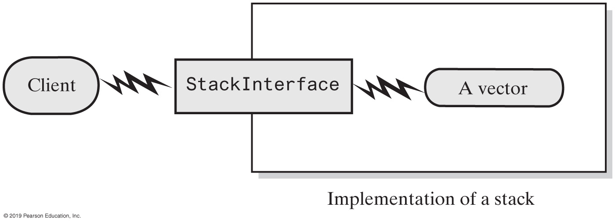
Vector-Based Stack Implementation
FIGURE 6-6 A client using the methods given in StackInterface; these methods interact with a vector’s methods to perform stack operations

Slide 51
Vector-Based Stack Implementation
import java.util.Vector;
/** A class of stacks whose entries are stored in a vector. */
public final class VectorStack<T> implements StackInterface<T>
{
private Vector<T> stack; // Last element is the top entry in stack
private boolean integrityOK;
private static final int DEFAULT_CAPACITY = 50;
private static final int MAX_CAPACITY = 10000;
public VectorStack()
{
this(DEFAULT_CAPACITY);
} // end default constructor
public VectorStack(int initialCapacity)
{
integrityOK = false;
checkCapacity(initialCapacity);
stack = new Vector<>(initialCapacity); // Size doubles as needed
integrityOK = true;
} // end constructor
// < Implementations of checkIntegrity, checkCapacity, and the stack
// operations go here. >
// . . .
} // end VectorStack
LISTING 6-3 An outline of a vector-based implementation of the ADT stack

Slide 52
Vector-Based Stack Implementation
public void push(T newEntry)
{
checkIntegrity();
stack.add(newEntry);
} // end push
Adding to the top

Slide 53
Vector-Based Stack Implementation
public T peek()
{
checkIntegrity();
if (isEmpty())
throw new EmptyStackException();
else
return stack.lastElement();
} // end peek
Retrieving the top

Slide 54
Vector-Based Stack Implementation
public T pop()
{
checkInitegrity();
if (isEmpty())
throw new EmptyStackException();
else
return stack.remove(stack.size() - 1);
} // end pop
Removing the top

Slide 55
Vector-Based Stack Implementation
public boolean isEmpty()
{
checkIntegrity();
return stack.isEmpty();
} // end isEmpty
public void clear()
{
checkIntegrity();
stack.clear();
} // end clear
The rest of the class.

